Slide 1


SENTIMENT ANALYSIS PROJECT
PHASE 1

Slide 2
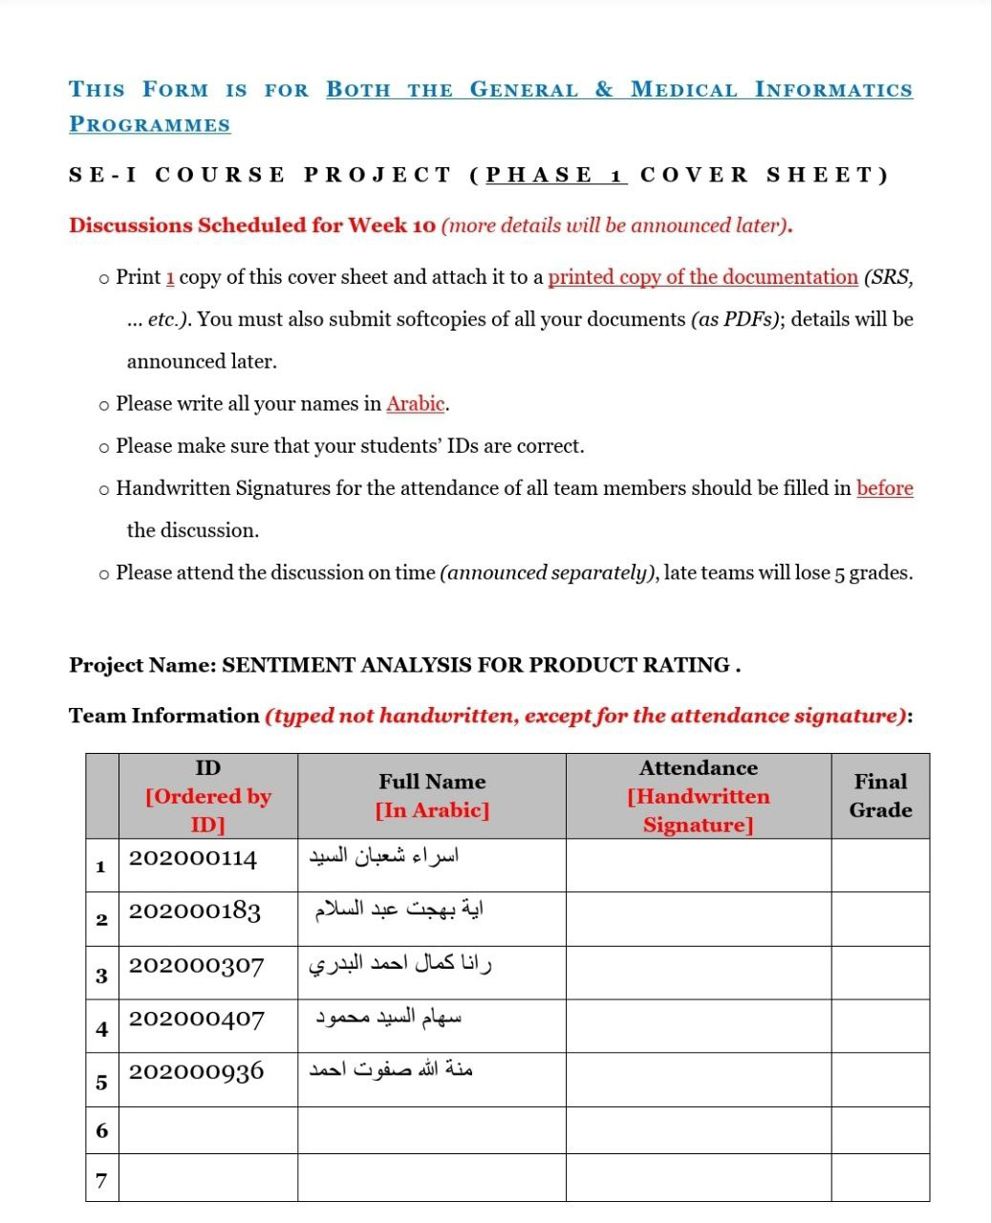
TEAM INFORMATION

Slide 3
REQUIRMENTS
Function : Rating The Product According To The Comments By Users
Description : The System Will Compare The Comments By Keywords In The Database Added By The Admin
Inputs : The Users’ Comments On The Product
Source : The Keyword That The Admin Had Added In The Database Before
Outputs : The Product’s Rate
Action : The Admin Shall Be Allowed To Put Keyword In The Database To Be Compared To The User’s Comment On The Product .
Independent Of That The System Will Rate The Product Whether It is ( Fantastic , Very Good , Good , Bad , Very-
Bad) Then Notify The User About The Products , Emails and So On ….
The Admin Shall Be Had The Accessibility Of The Database TO Add , Change and Delete Products And Keywords
_ WHICH IN THE DATABASE _ , Send Emails To Users and See Users’ History .

Slide 4
REQUIRMENTS
Requirement : There Are Products To Be Rate and Comments To Be Compared To Keywords In The Database .
Pre _ Condition : The User Had Been Registered and Login To The Website.
The Admin Had Been Registered and Login To The Website.
Post_ Condition : The User Shall Be Abled To Write A Comment To Compare To The Keywords In The Database That Has Added
By The Admin .

Slide 5
FUNCTIONAL REQUIRMENT
Registration
Login
Logout
Delete Comment
Add Comment
Change Comment
Reply Comment
Add Product
Delete product
Update Product
Order
Cancel Order
Payment
Email

Slide 6
CONT . FUNCTIONAL REQUIRMENT
Similar Product
Verify Password
Check Username
Search
Notification
Delete Low – Rate Product
Report
View Product
Performance
Compare Words

Slide 7
NON_FUNCTIONAL REQUIREMENT
SECURITY
PREFORMANCE
USER FRIENDLY
USABLE
USEFUL
RELIABILITY
AVAILABILITY
TESTABILITY

Slide 8
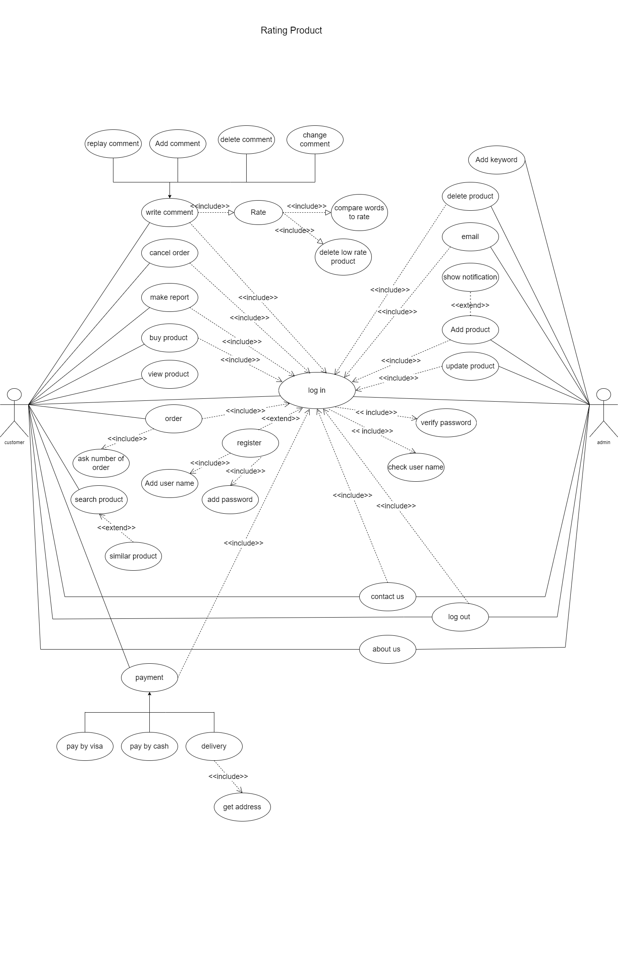




USE CASE DIAGRAM

Slide 9
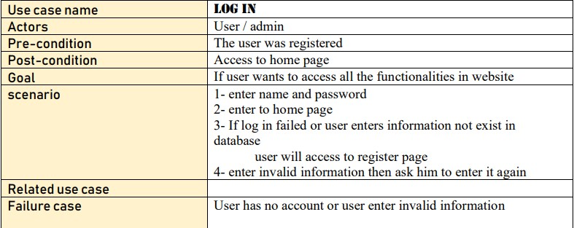
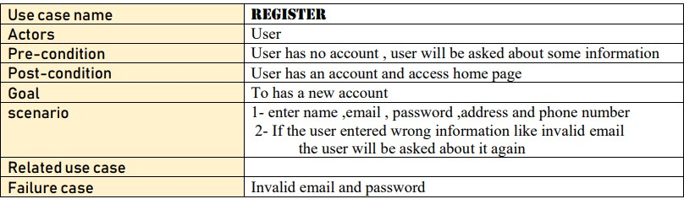
USECASE DISCRIPTION

Slide 10
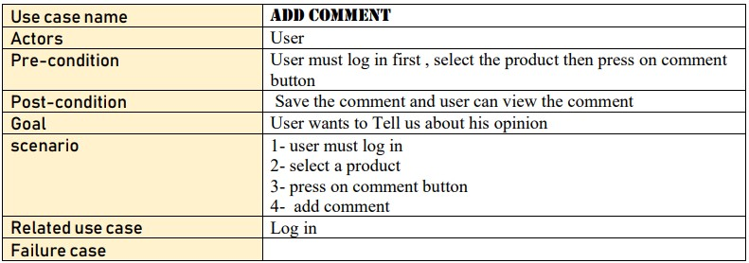
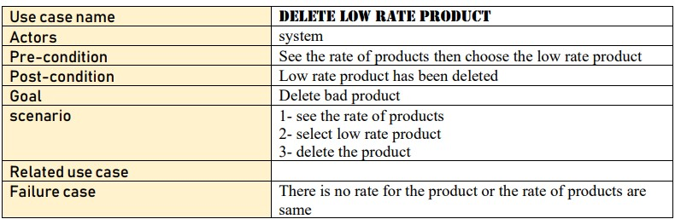
USECASE DISCRIPTION

Slide 11
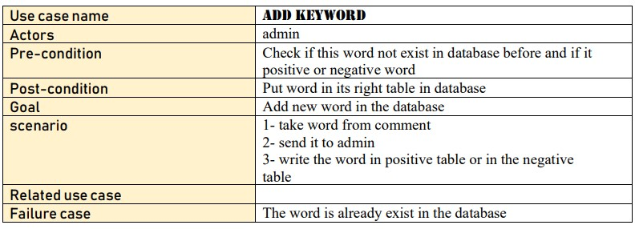
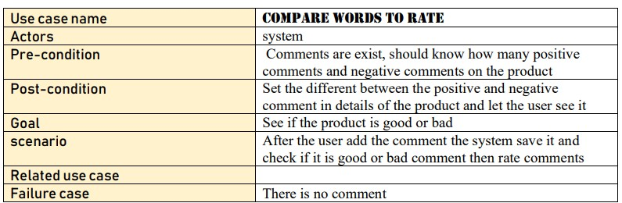
USECASE DISCRIPTION

Slide 12
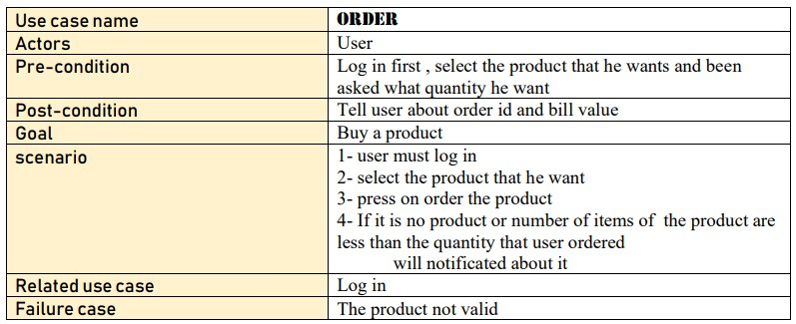
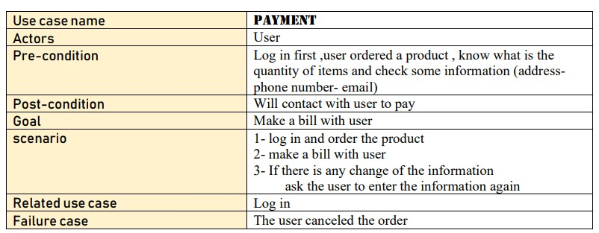
USECASE DESCRIPTION

Slide 13
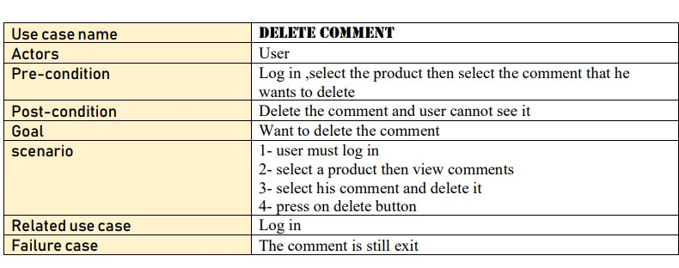
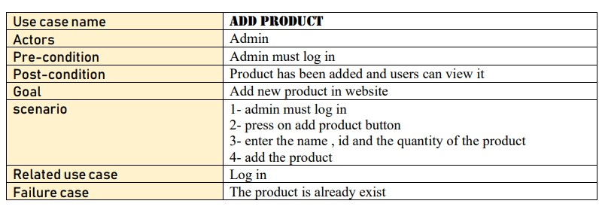
USECASE DESCRIPTION

Slide 14
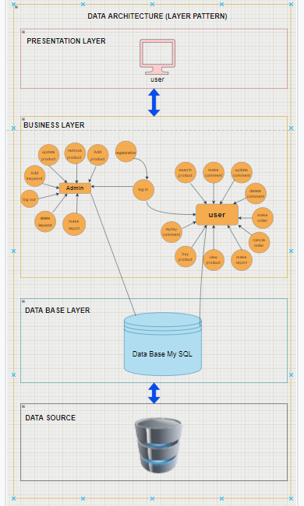
SYSTEM ARCHITECTURE
USING LAYER PATTERN

Slide 15
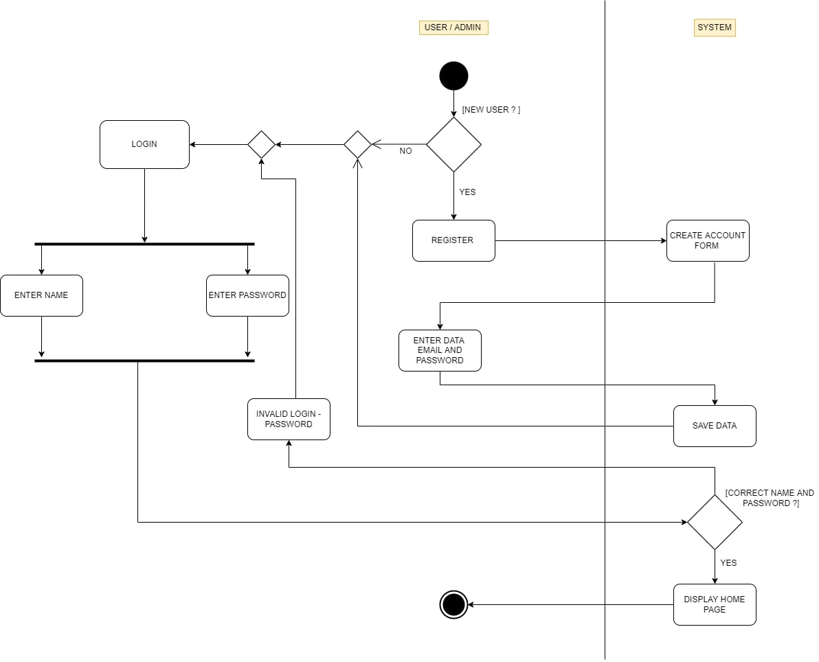
ACTIVITY DIAGRAM
FOR LOGIN FUNCTION

Slide 16
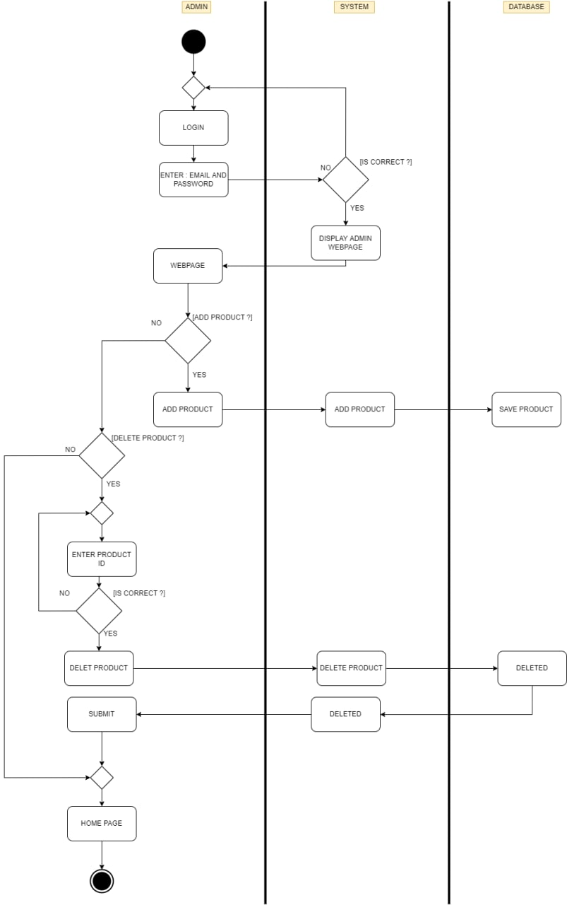
ACTIVITY DIAGRAM
FUNCTION FOR ADMIN ADD PRODUCT

Slide 17
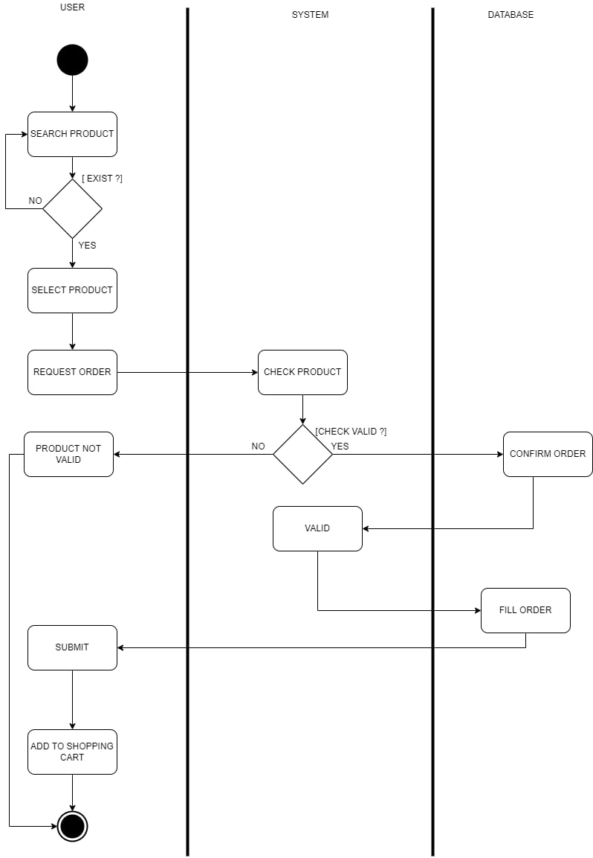
ACTIVITY DIAGRAM
FOR OADER FUNCTION

Slide 18
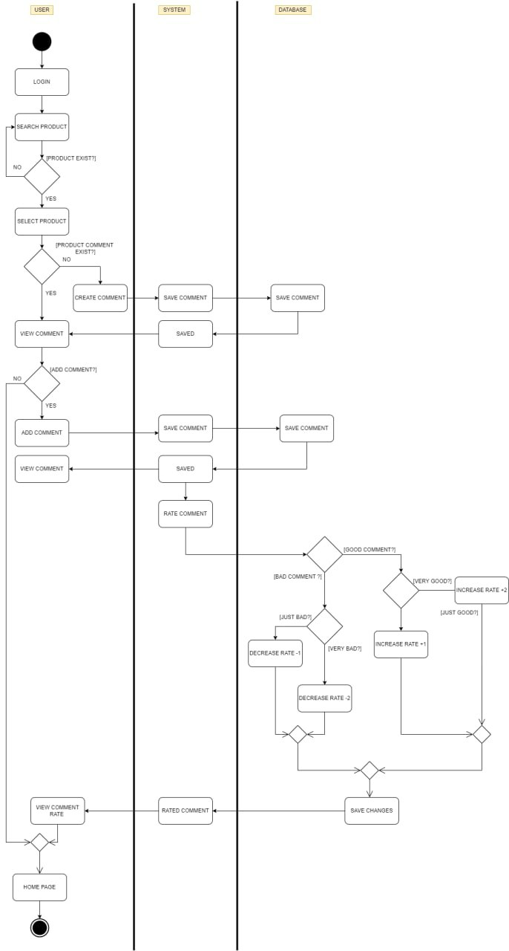
ACTIVITY DIAGRAM
ADD AND CREATE COMMENT

Slide 19
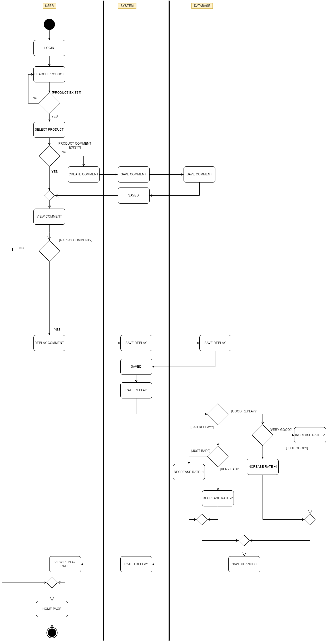
ACTIVITY DIAGRAM
REPLAY COMMENT

Slide 20
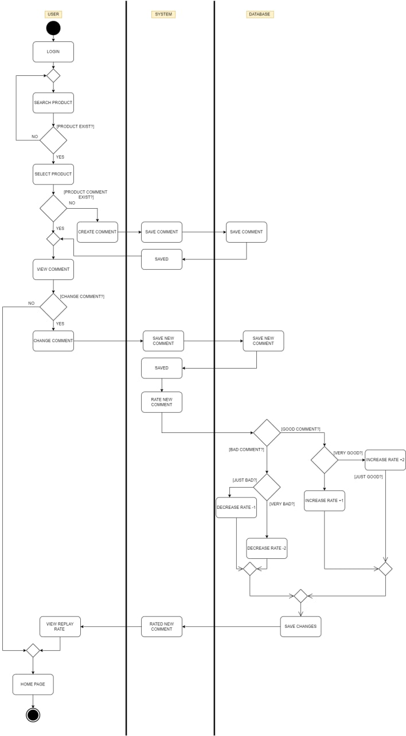
ACTIVITY DIAGRAM
CHANGE COMMENT

Slide 21
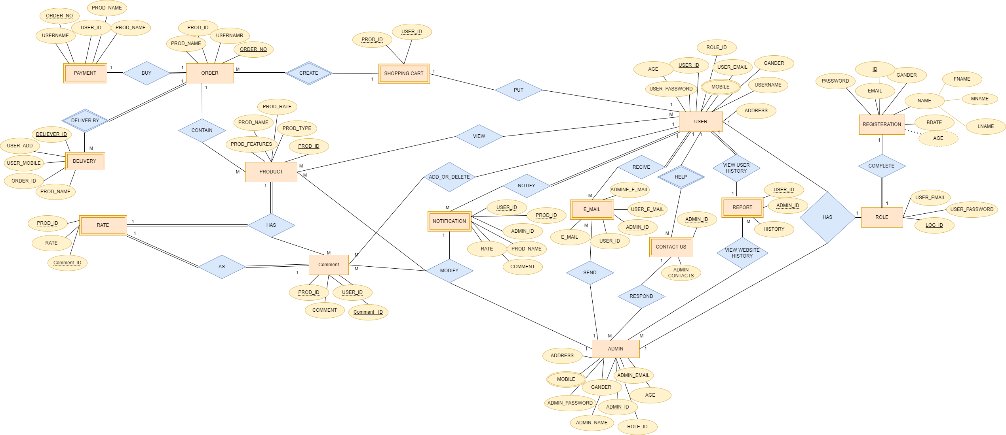
Database ERD

Slide 22
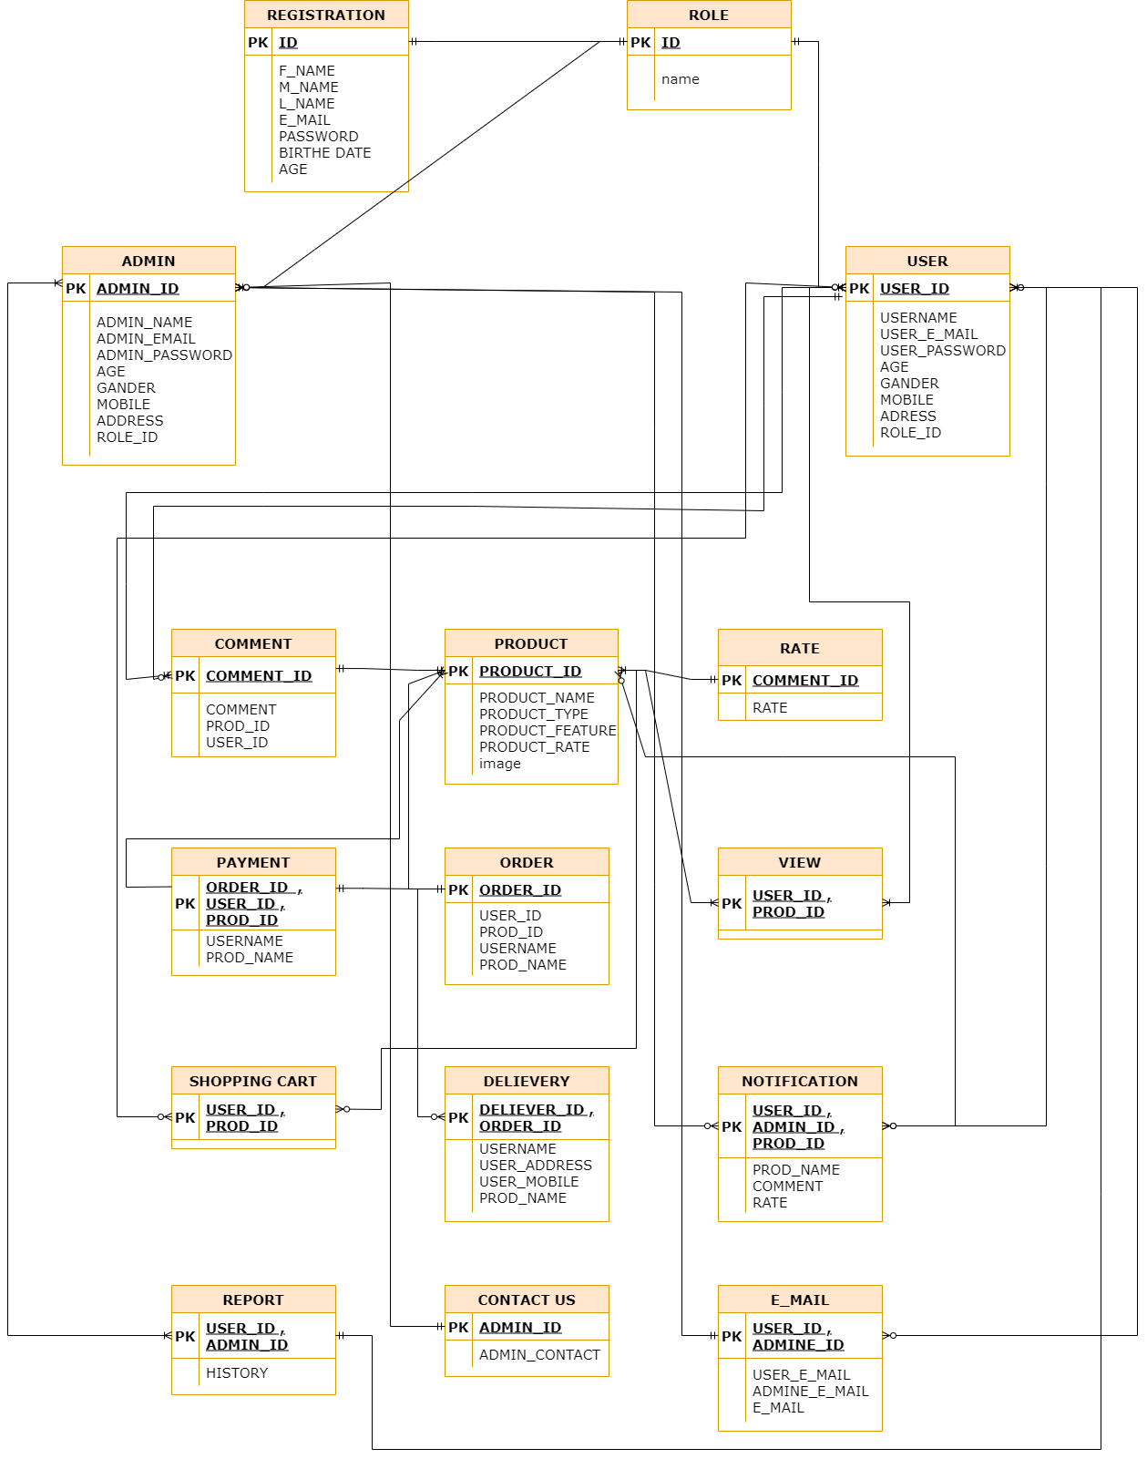
DATABASE TABELS

Slide 23
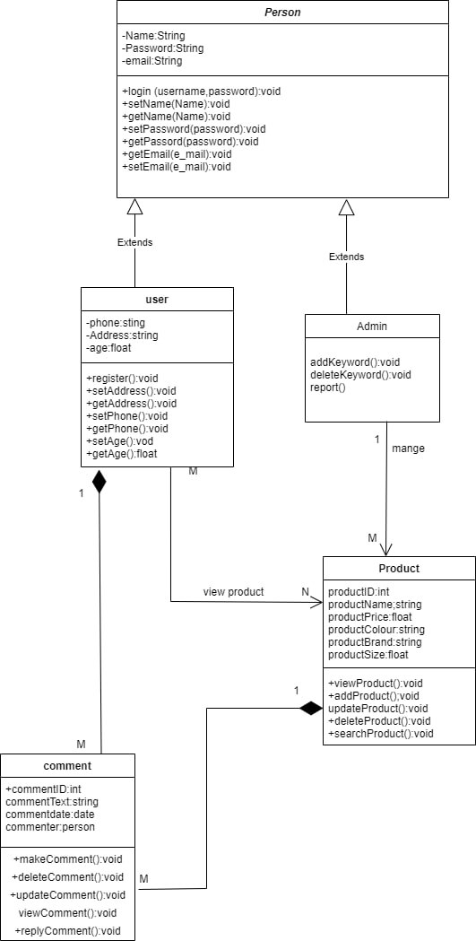
Class Diagram
VERSION 2

Slide 24
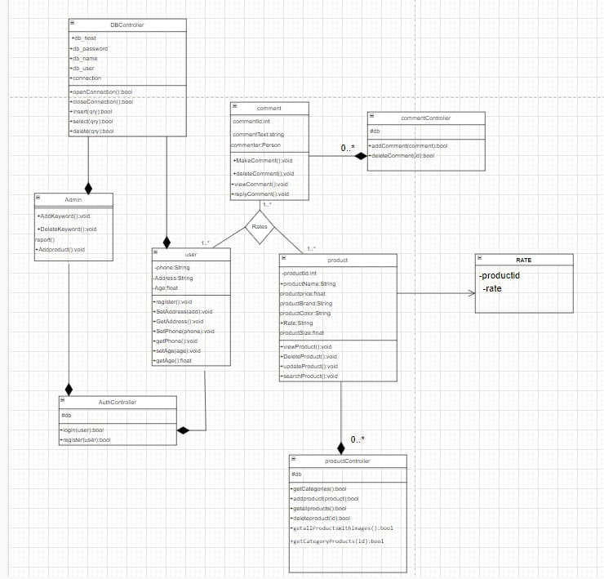
Class Diagram
VERSION 3

Slide 25
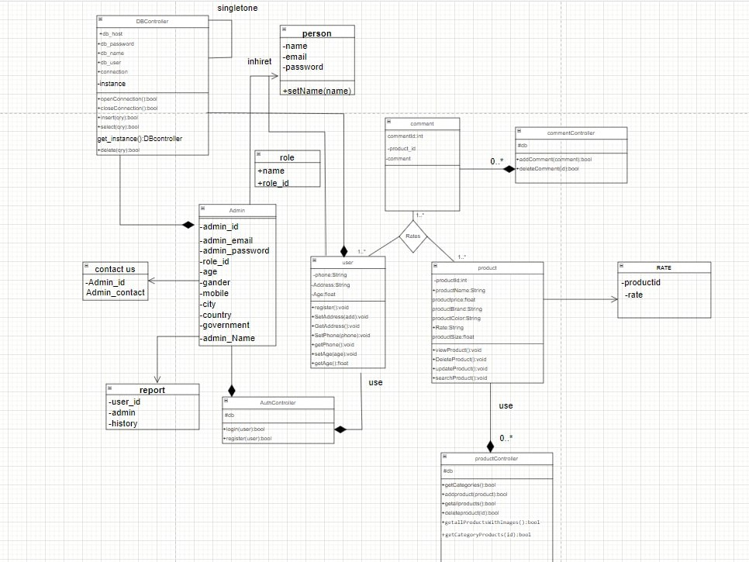
Class Diagram
DESIGN
PATTERN
(SINGLETON)

Slide 26
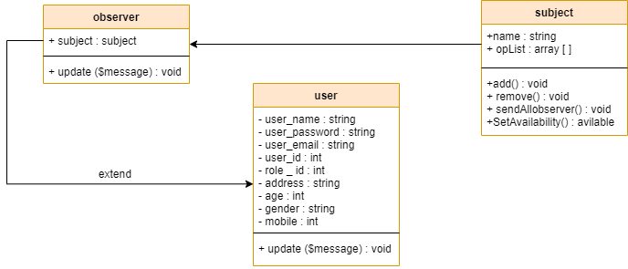
Class Diagram
DESIGN
PATTERN
(OBSERVER)

Slide 27
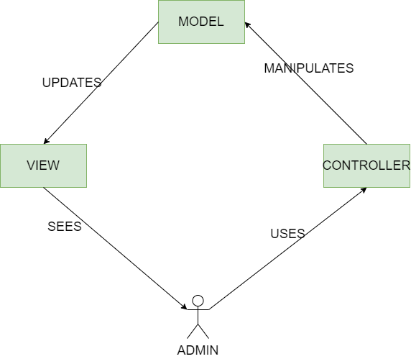
CLASS
DIAGRAM
DESIGN
PATTERN
(MVC)

Slide 28
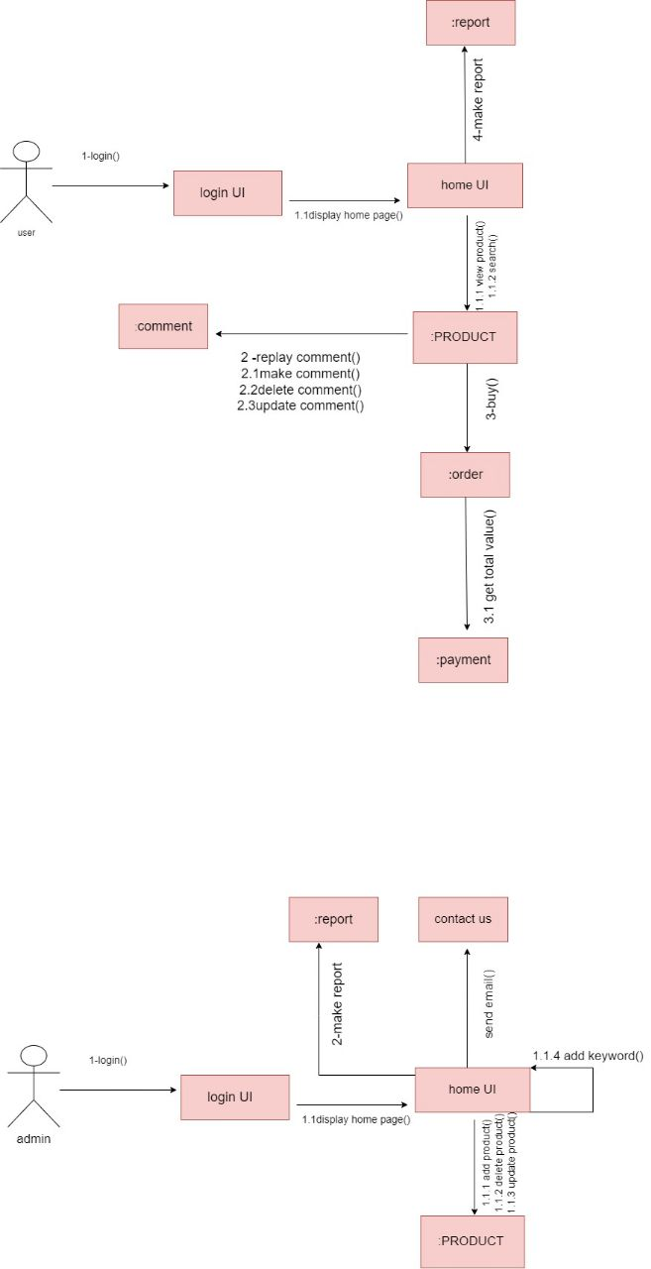
COMMUNICATION
DIAGRAM

Slide 29
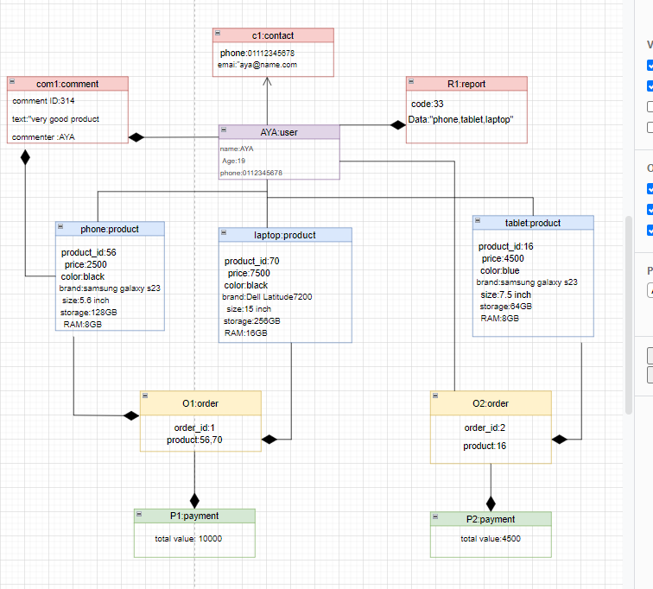
OBJECT DIAGRAM
FOR USER

Slide 30
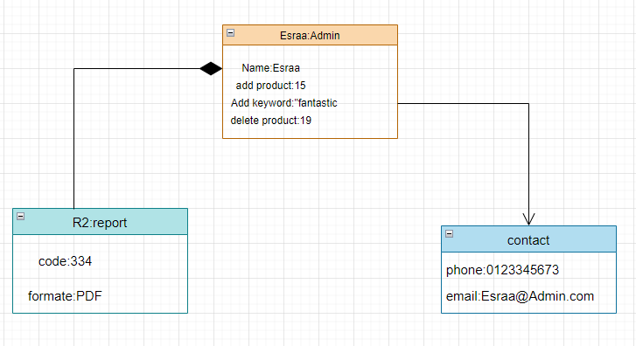
OBJECT DIAGRAM
FOR ADMIN

Slide 31
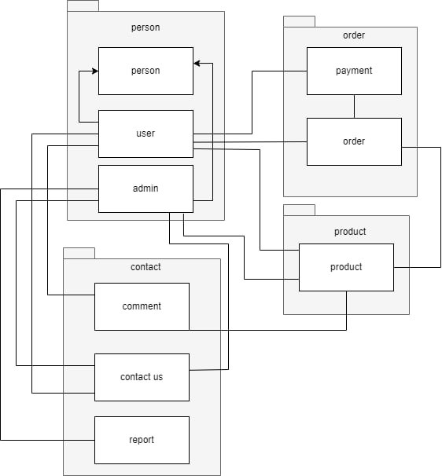
PACKAGEDIAGRAM

Slide 32
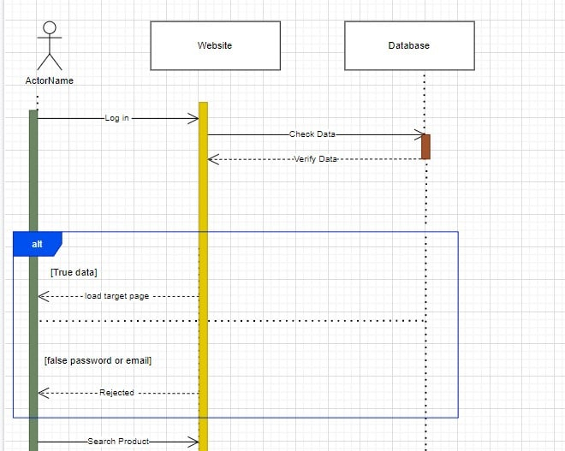
SEQUENCE
DIAGRAM
SYSTEM SEQUENCE ..PART 1

Slide 33
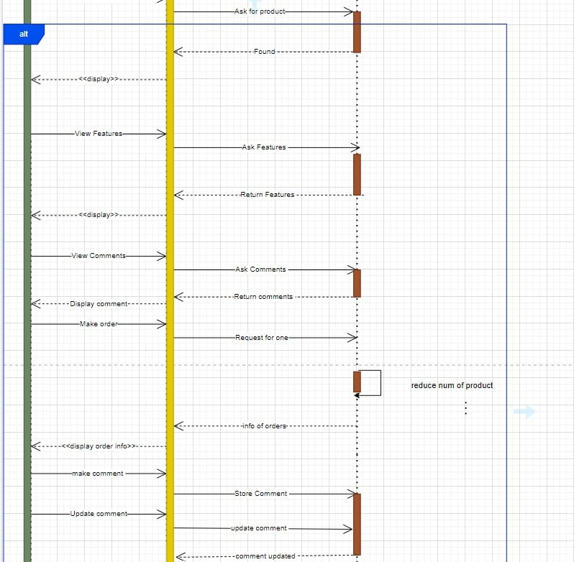
SEQUENCE
DIAGRAM
SYSTEM SEQUENCE
PART 2

Slide 34
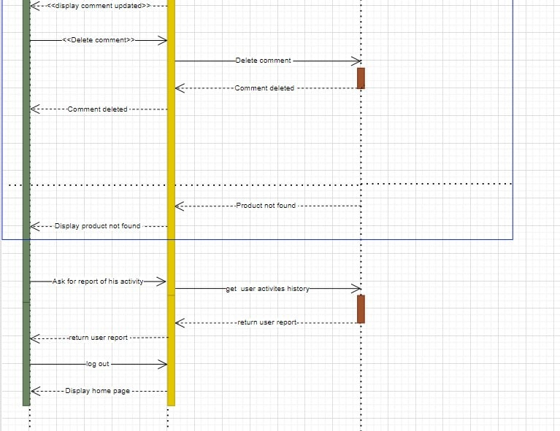
SEQUENCE
DIAGRAM
SYSTEM SEQUENCE
..PART 3

Slide 35
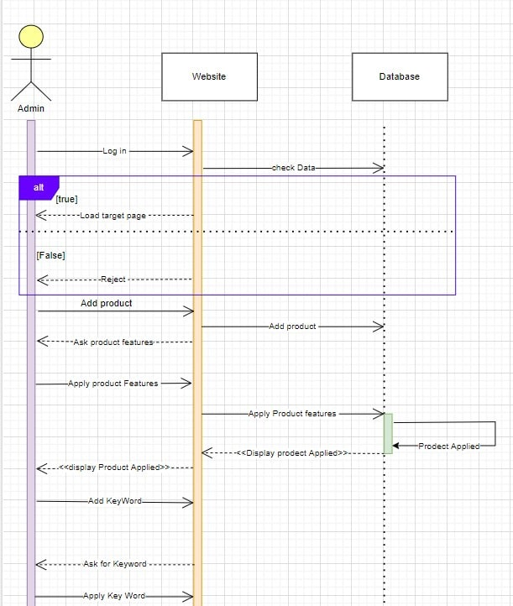
SEQUENCE
DIAGRAM
ADMIN SCENARIO
..PART 1

Slide 36
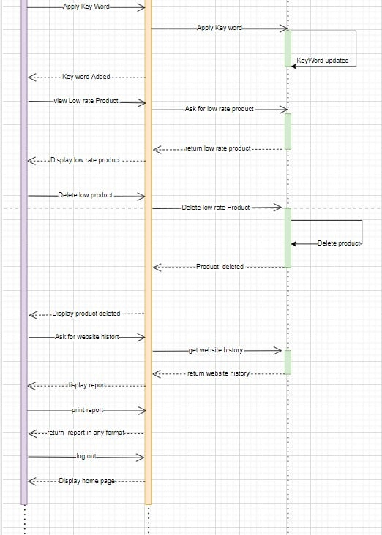
SEQUENCE
DIAGRAM
ADMIN SCENARIO
..PART 2

Slide 37
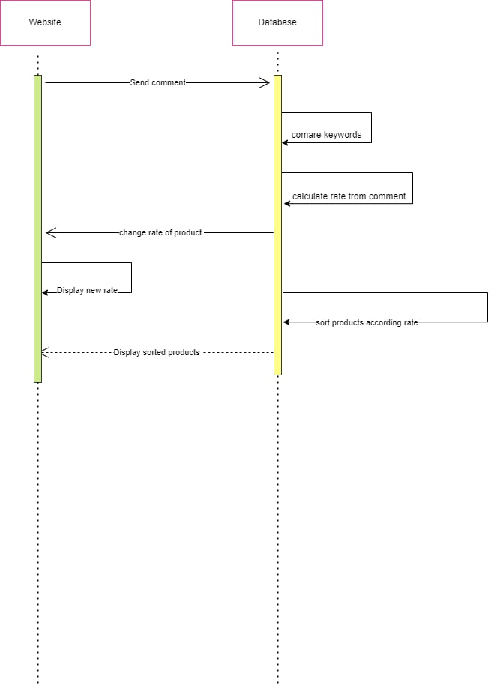
SEQUENCE
DIAGRAM
COMPARE FUNCTION

Slide 38
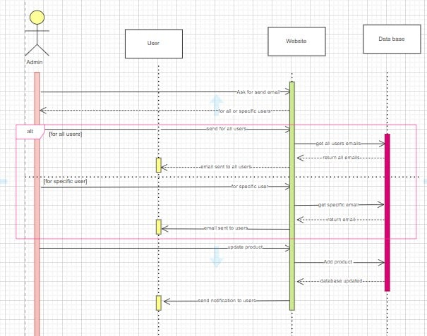
SEQUENCE
DIAGRAM
SENDING E_MAIL &NOTIFICATION

